Slide 1
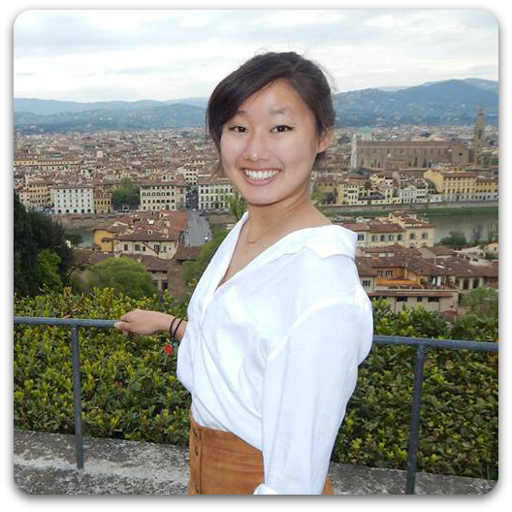
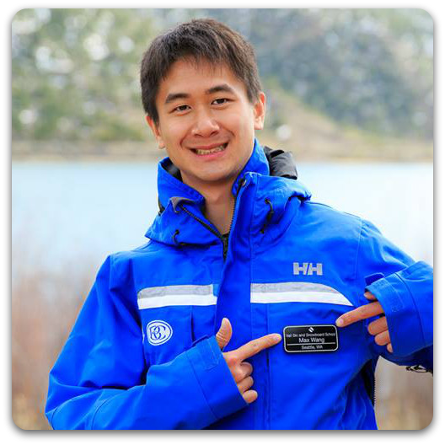
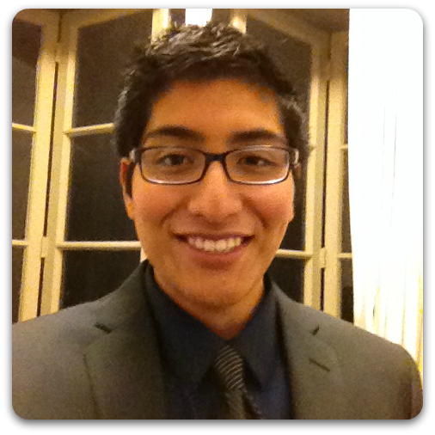
POVs & Experience Prototypes
Hali
Max
Doshi

Slide 2
Problem Domain
Remedying the difficulties and worries that may arise for anyone traveling to unfamiliar destinations.

Slide 3
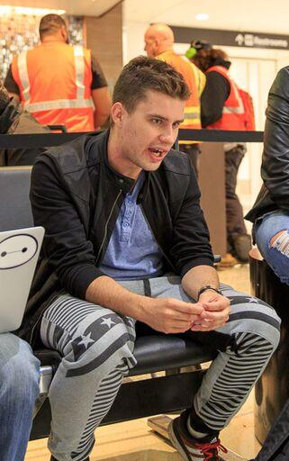
POV - Preparation
We met Maruk, a frequent international traveler.
We were amazed to find that he often traveled spontaneously, and thus, would go to a foreign country unprepared both logistically and culturally.
It would be game changing if we could help him better prepare so travel feels more natural.

Slide 4
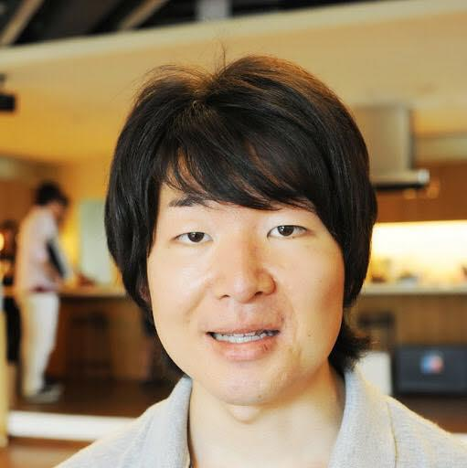
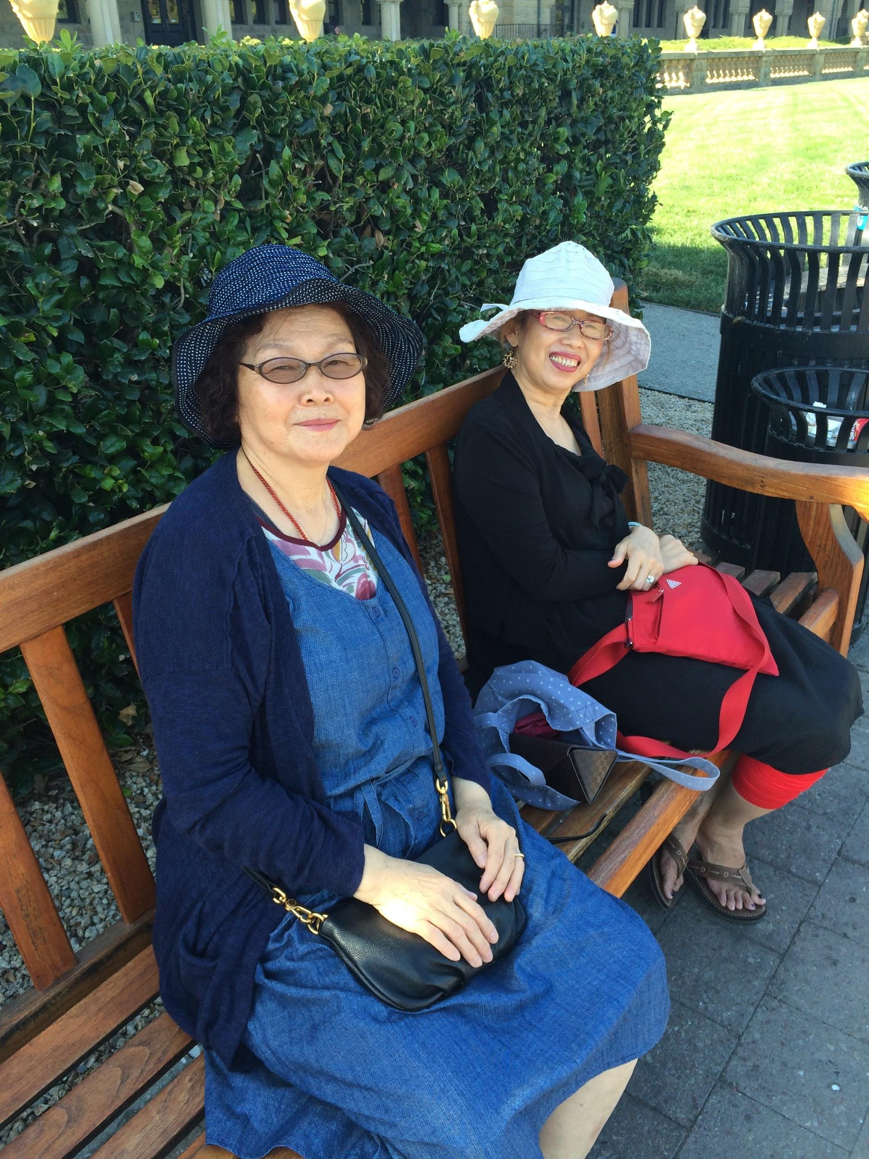
Interviews
Genki
24 years old
Japanese
Karina
20 years old
American
Lan De
65 years old
Chinese

Slide 5
Results
“Usually stay home in comfort zone” - Genki
“We stayed in a traditional hotel [in Japan]. We didn’t know how to use the toilets, showers, and sleeping areas” - Karina
“The world is a very big place” - Lan De
Notes:
There is a need to feel connected and to explore the rest of the world.
Certain everyday cultural norms can be shocking to people of different cultures.
Being able to remember experiences is very satisfying.

Slide 6
POV - Storing Experiences
We met Ami, a flight attendant who travels frequently.
We were amazed to find that some flight attendants keep online travel journals, but Ami doesn’t journal because it takes too much time and effort.
It would be game changing to have an easy way to store experiences for future reference and sharing.

Slide 7
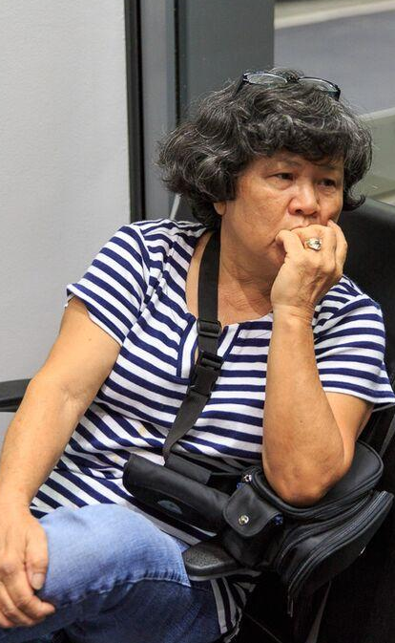
POV - Staying Connected
We met Mariko, an older woman from Japan
We were amazed to find that she searched for public wifi and phonebooths to communicate with loved ones while traveling.
It would be game changing to provide an efficient way to stay connected while traveling.

Slide 8
POV - Displaying Necessities
We met Karina, a student who travels out of the country at least once a year.
We were amazed to find that travelers must know the nearest locations of necessities, such as restrooms, when traveling.
It would be game changing to easily fulfill the needs of travelers

Slide 9
How Might We… Ami - Flight Attendant
remind her to record experiences
connect her travel experiences to her average life
make documenting a collaborative process
How might we help her focus on and preserve the moment?

Slide 10
How Might We… Mariko - International Traveler
encourage the reverse and have others communicate with the user
help her find connections in her immediate surroundings
make the travel experience less isolating
How might we let her family and friends travel with her or feel like they’re with her?

Slide 11
How Might We… Karina - Student
decrease the needs of travelers
help her be more flexible in her needs
involve strangers/locals in the hunt for necessities
How might we help accommodate individual travelers’ needs and provide her with the convenience of home when she’s on-the-go?

Slide 12
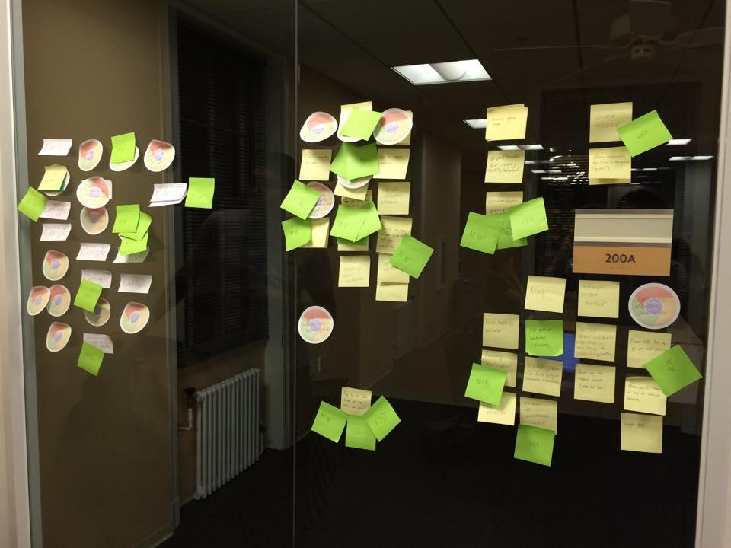
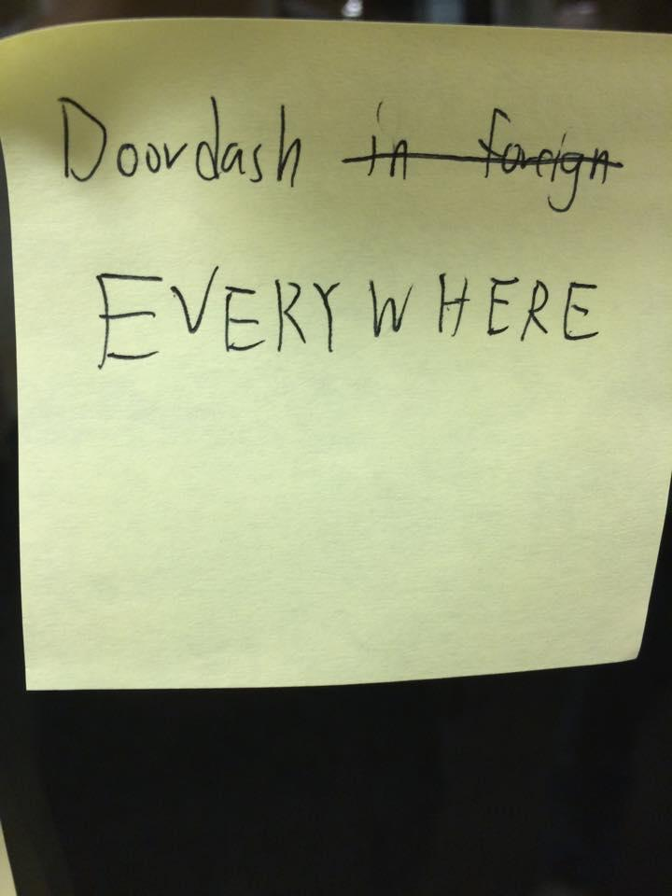
Solutions
EventPOP
Cultural Translation
Tasker

Slide 13
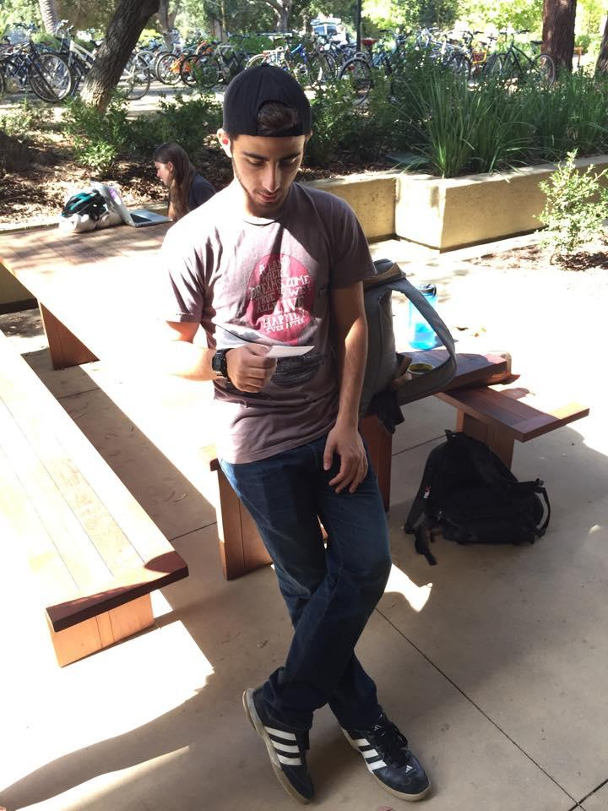
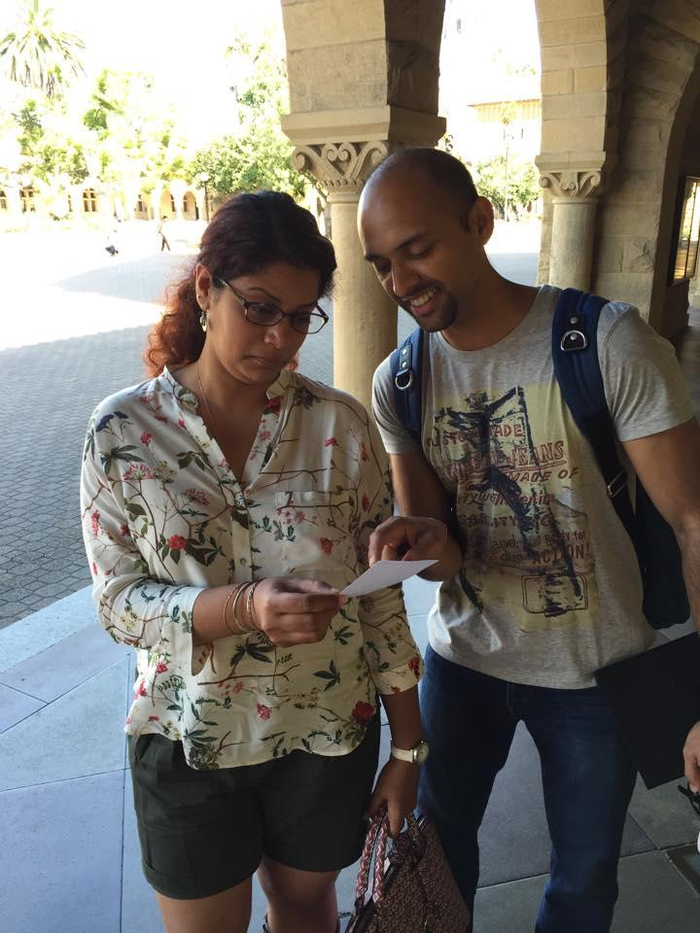
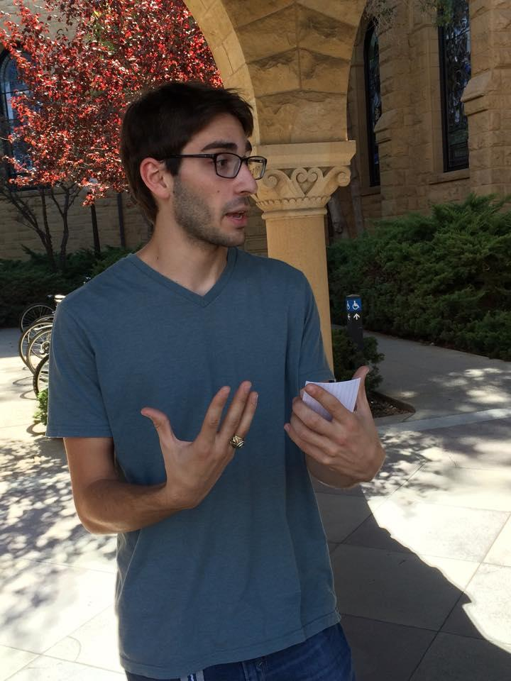
User Testers
Juan
Dominican
Republic
Monica + Nil
South Korea
Jordan
America

Slide 14
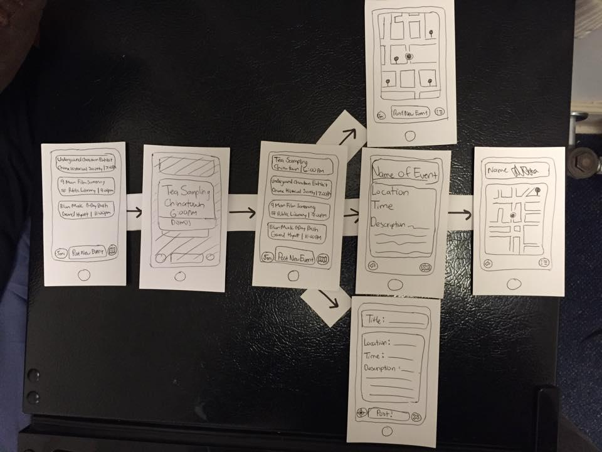
Experience Prototype #1 - EventPOP

Slide 15
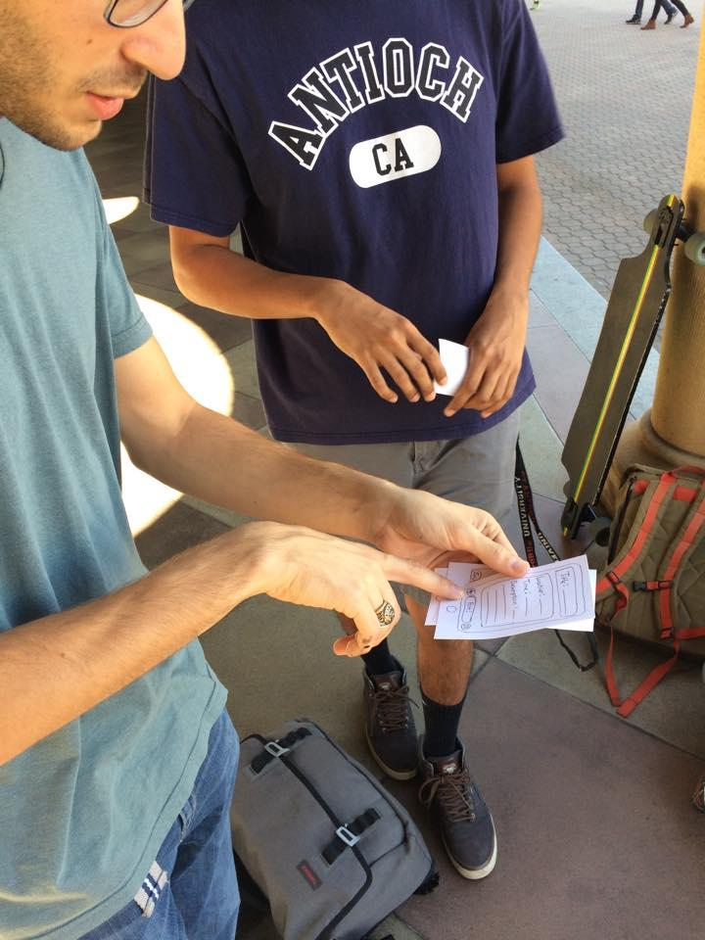
Results & Validity
Simple, intuitive interface
Pop up events could be disrupting
Posting an event is not as intuitive as finding an event
Users enjoy planning beforehand
Conclusion: Adds spontaneity, but a user with plans would only go to events if they had extra time

Slide 16
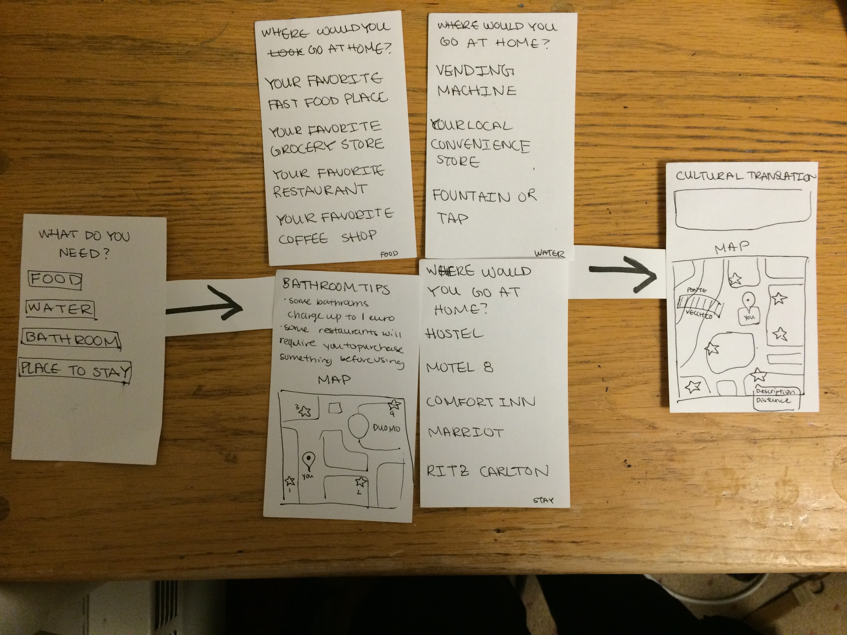
Experience Prototype #2 - Cultural Translation

Slide 17
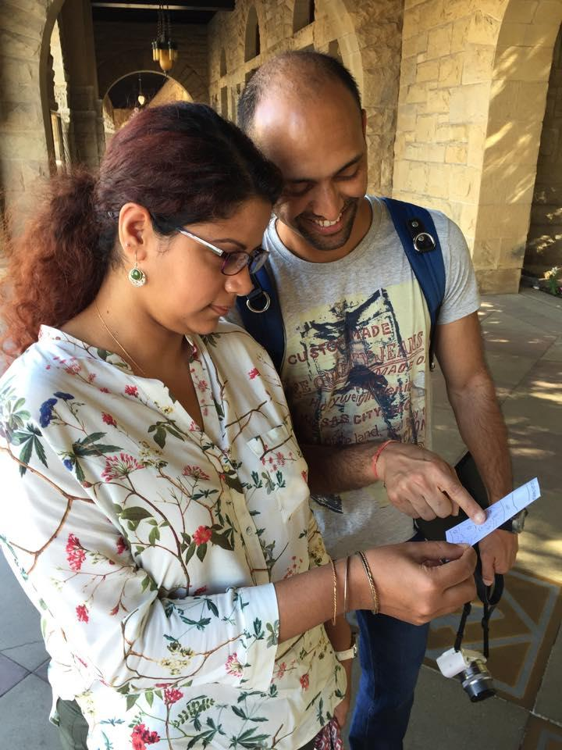
Results & Validity
Linear flow helps identify user needs
Assumes that user has American cultural background
Could include more basic needs
Relation to “what would you do at home” draws cultural parallel
Conclusion: Simplicity helps hone in on cultural parallels to basic needs
But app needs to be aware of user’s culture

Slide 18
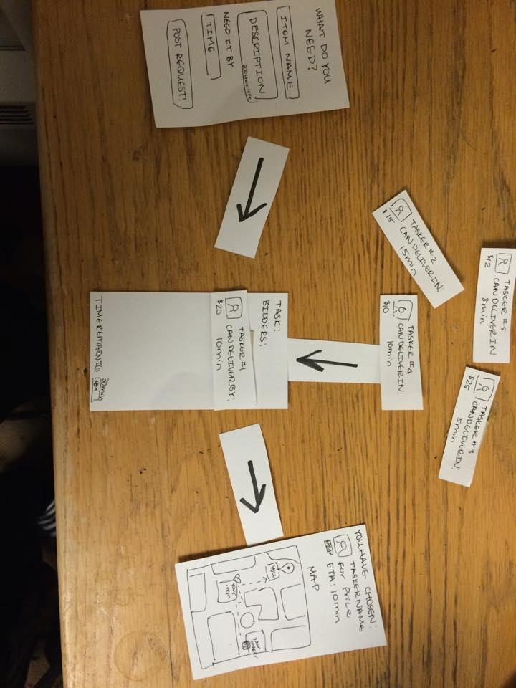
Experience Prototype #3 - Tasker

Slide 19
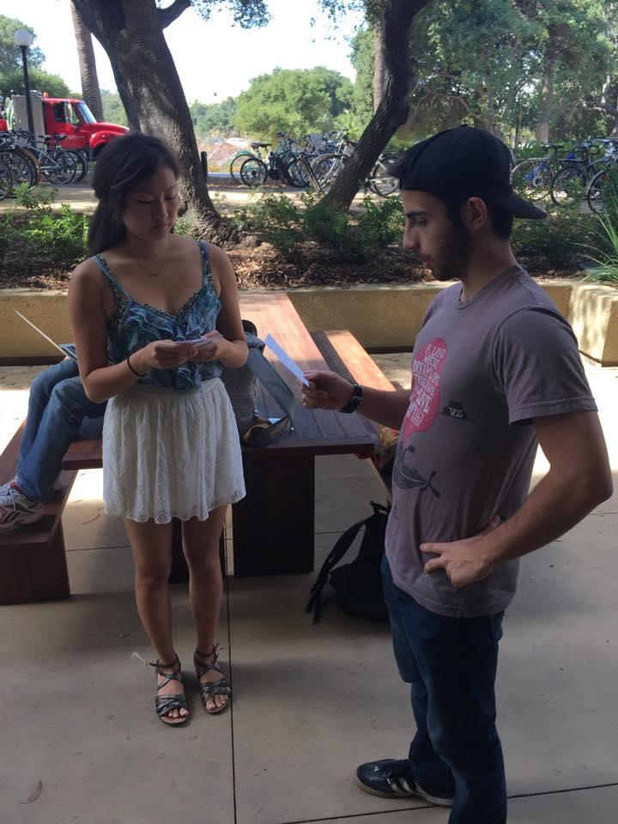
Results & Validity
User can stay in familiar area
Visibility between user and tasker is important
Unclear if can request product or service
Unclear how to pay for delivery
Conclusion: App felt more like an on-demand delivery service than a way to navigate a foreign place

Slide 20
Summary
Original POVs related to storing experiences, displaying necessities, and staying connected.
Best solutions came from storing experiences and displaying necessities
EventPOP and Cultural Translation were best able to communicate their purpose and Cultural Translation had a simpler interface.
Tasker came across as an on-demand service.
We would love your feedback on our prototypes.

